Slide 1
Pattern Recognition
Chapter 3: Probability measures for pattern classification _part I

Slide 2
Outline
Motivation
Bayesian classifier
Maximum a posteriori classifier
Maximum likelihood classifier

Slide 3
Why use probability measures
Great variability may occur within a class of pattern due to measurement noise(e.g., image noise and warping) and inherent variability(apples can vary in size and shape)
We tried to account for these variabilities by treating patterns as random vectors
In the MICD classifier, we account for this variability by incorporating statistical parameters of the class (e.g., mean and variance)
This works well for scenarios where class distributions can be well modeled based on Gaussian statistics, but may perform poorly when the class distributions are more complex and non-Gaussian.
How do we deal with this?

Slide 4
Why use probability measures
Idea: what if we have more complete information about the probabilistic behavior of the class?
Given known class conditional probability density distributions, we can create powerful similarity measures that tell us the likelihood, or probability, of each class given an observed pattern.
Classifiers built on such probabilistic measures are optimal in the minimum probability of error sense.

Slide 5
Bayesian classifier
Consider the two class pattern recognition problem:
  Given an unknown pattern x, assign the pattern to either class A or class B.
A general rule of statistical decision theory is to minimize the “cost” associated with making a wrong decision.
  e.g., amount of money lost by deciding to buying a stock that gets delisted the next day and is actually a “don’t buy”.

Slide 6

Bayesian classifier
Let L_{ij} be the cost of deciding on class c_{j} when the true class is c_{i}
The total risk associated with deciding x belongs to c_{j} can be defined by the expected cost:
Where K is the number of classes and P(c_{i} |x) is the posterior distribution of class c_{i} given the pattern x.

Slide 7
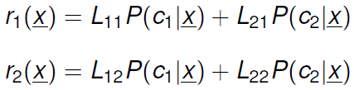
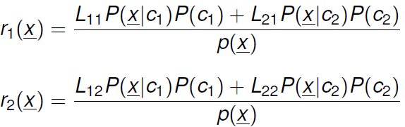
Bayesian classifier
For the two class case:
Applying bayesian’s rule gives us:

Slide 8

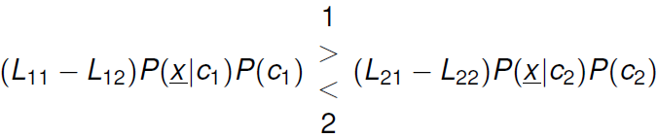
Bayesian classifier
The general K-class Bayesian classifier is defined as follows, and minimizes total risk:
For the two class case:
How do you choose an appropriate cost?

Slide 9

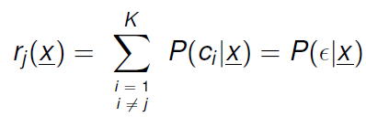
Choosing cost functions
The most common cost used in the situation where no other cost criterion is known is the “zero-one” lost function:
Meaning: all errors have equal costs.
Given the “zero-one” loss function, the total risk function becomes:
So minimizing total risk in this case is the same as minimizing probability of error!

Slide 10
Types of probabilistic classifiers
Using the ‘zero-one’ loss function, we will study two main types of probabilistic classifiers:
  Maximum a Posteriori(MAP) probability classifier
  Maximum Likelihood(ML) classifier

Slide 11
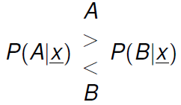
MAP clssifier
Given two classes A and B, the MAP classifier can be defined as follows:
Where P(A|x) and P(B|x) are the posterior class probabilities of A and B, respectively, given observation x.
Meaning: All patterns with a higher posterior probability for A than for B will be classified as A, and all patterns with a higher posterior probability for B than for A will be classified as B.

Slide 12
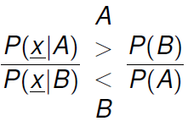
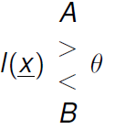
MAP classifier
Class probability models usually given in terms of class conditional probabilities P(x|A) and P(x|B)
More convenient to express MAP in the form:
Where I(x) is the likelihood ratio and θ is the threshold.

Slide 13
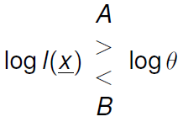
MAP classifier
When dealing with probability density functions with exponential dependence(e.g., Gamma,Gaussian, etc.), it is more convenient to deal with MAP in the log-likelihood form:

Slide 14
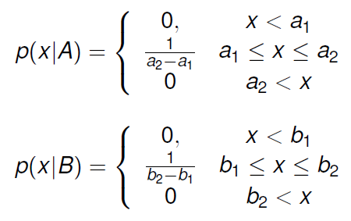
MAP classifier:example
Suppose we are given a two-class problem, where P(x|A) and P(x|B) are given by:
Where b₁>a₂>a₁>b₁
Assuming P(A)=P(B)=1/2, develop the MAP classification strategy.

Slide 15
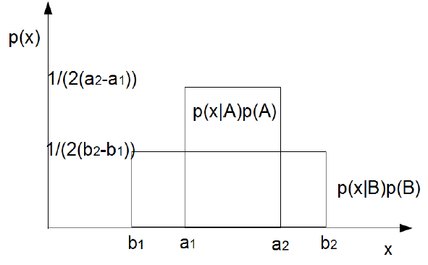
MAP classifier:example

Slide 16
MAP classifier:example
The MAP classification strategy can be defined as:
  b1<x<a1: decide class B
  a1<x<a2: decide class A
  a2<x<b2: decide class B
  Otherwise: no decision

Slide 17
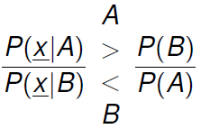
Maximum Likelihood classifier
Ideally, we would like to use the MAP classifier, which chooses the most probable class:
However, in many cases the prior P(A) and P(B) are unknown, making it impossible to use the posteriors P(A|x) and P(B|x).
Common alternative is, instead of choosing the most probable class, we choose the class that makes the observed pattern x most probable.

Slide 18
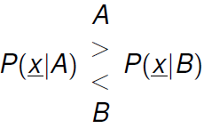
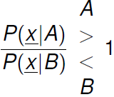
Maximum Likelihood classifier
Instead of maximizing the posterior, we instead maximize the likelihood:
In likelihood ratio form:
Can be viewed as special case of MAP where P(A)=P(B)

